Slide 1
Topic 13: Charged Particles
13.1 Electrons
13.2 Beams of charged particles

Slide 2
Charge of an Electron
1.6 × 10⁻¹⁹ C
e⁻
How do we manage to determine such a small value?
Thanks to Robert Millikan

Slide 3
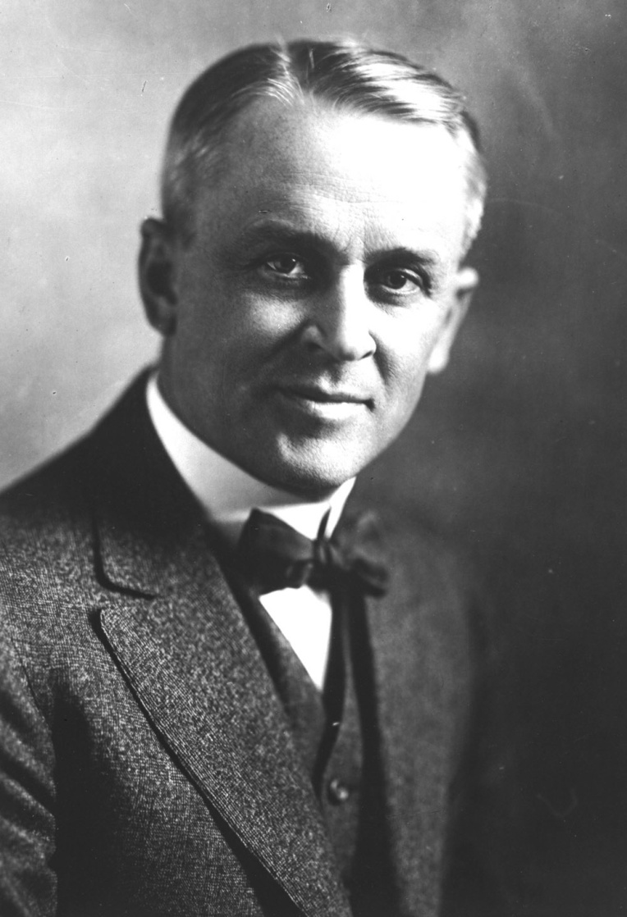
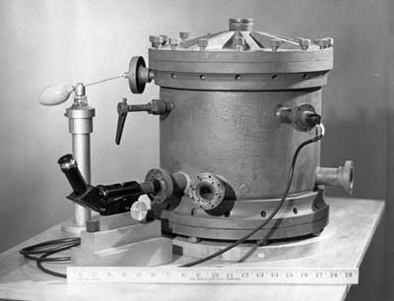
Millikan’s Oil Drop Experiment
1909
Robert Millikan
1868-1953

Slide 4
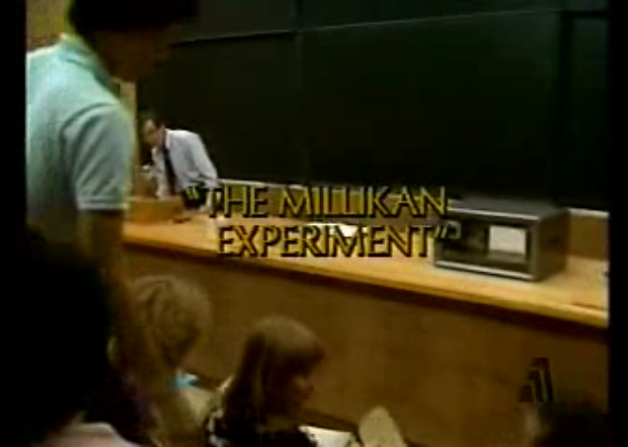
A Glimpse into Millikan’s Endeavour
http://video.google.com/videoplay?docid=2799052432147926032&ei=Q3unS4q4MIiEwgON9vn2CA&q=Millikan+Experiment+CalTech+12&hl=en#

Slide 5
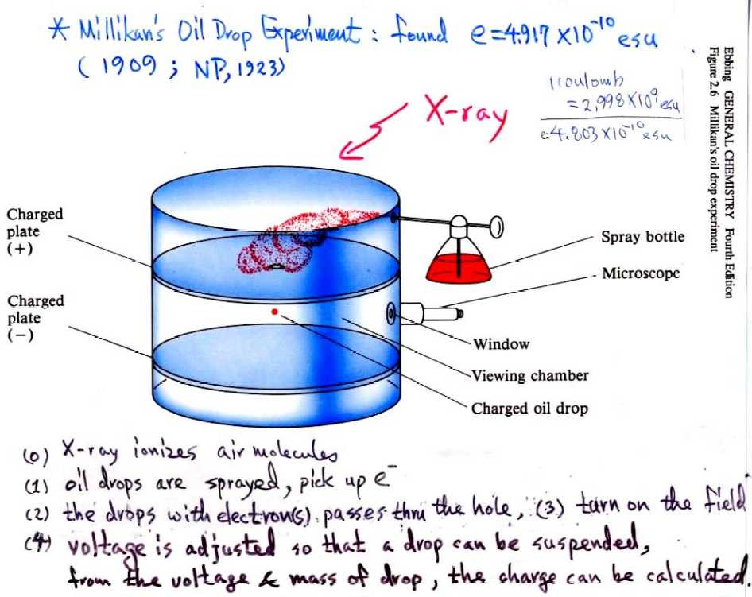
Millikan’s Endeavour

Slide 6
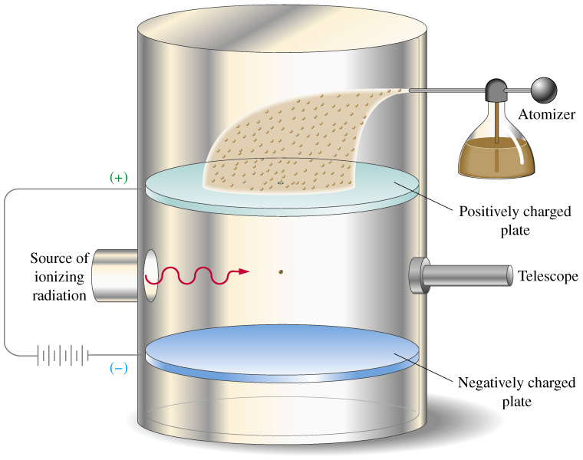
Millikan’s Apparatus

Slide 7
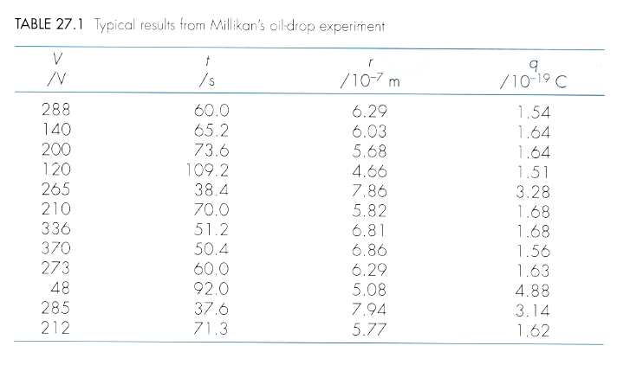
Millikan’s Results
Millikan found that charge is quantised into multiples of 1.6 × 10⁻¹⁹ C

Slide 8
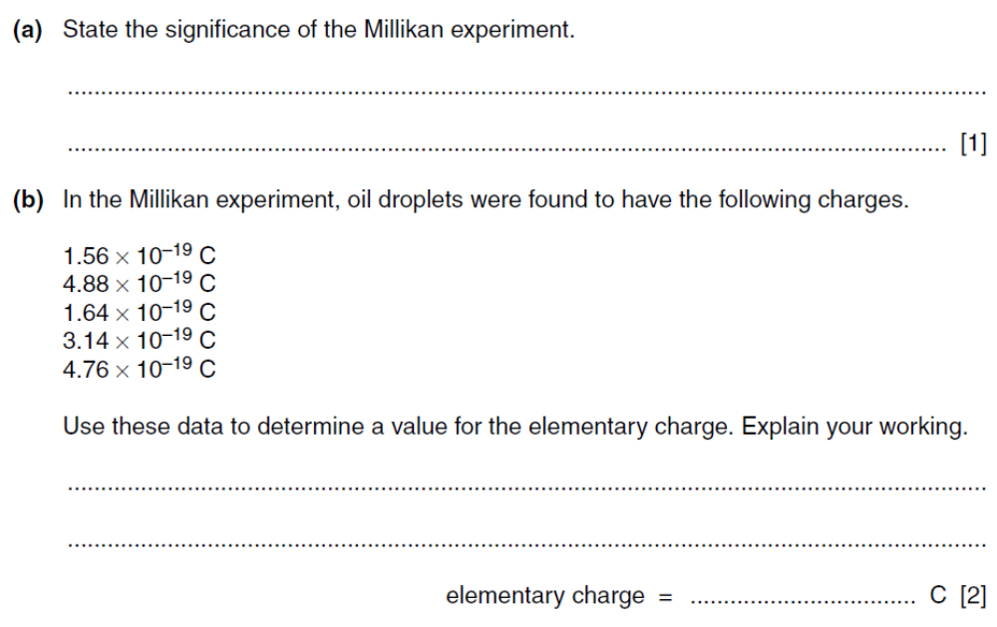
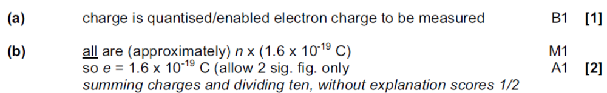
Example

Slide 9
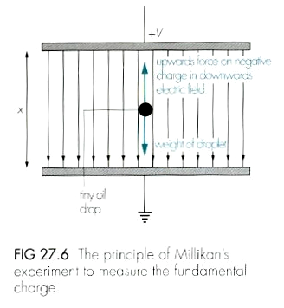
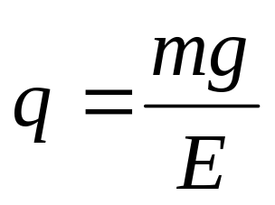
Between the Plates
Weight of a droplet
= Electric force on it
mg = qE
charge on oil droplet:
m = mass of droplet
q = charge on droplet
Upward force by the electric field
Weight of the droplet
Tiny oil drop

Slide 10
Weight of the Oil Droplet
Weight of oil droplet
= mg – upthrust
= Vρ_{oil} g – Vρ_{air} g
= Vg (ρ_{oil} – ρ_{air})
= 4/3 π r³ g (ρ_{oil} – ρ_{air})
How to find r ?

Slide 11
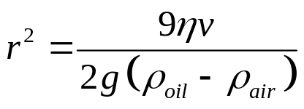
Determining radius
To determine the radius of the oil droplet, r, the electric field is switched off and the oil droplet allowed to fall with its terminal velocity.
The terminal velocity, v is measured by recording the time, t, for the droplet to fall through a measured distance, y.
When the oil droplet is falling with its terminal velocity, its
Weight = viscous drag on it
4/3 π r³ g (ρ_{oil} – ρ_{air}) = 6πrηv

Slide 12
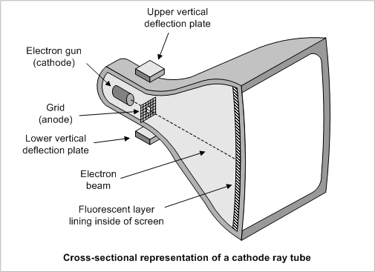
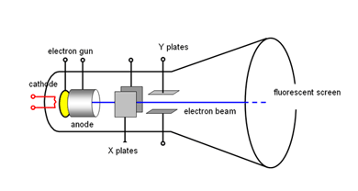
Production of Electron Beam
Cathode Ray Tube

Slide 13
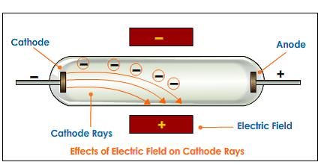
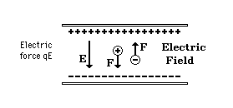
Electrons in an Electric Field
V V
d
0 V
Electric Force, F_{e} = e E
ma = e (V / d)
a = e V / m d

Slide 14
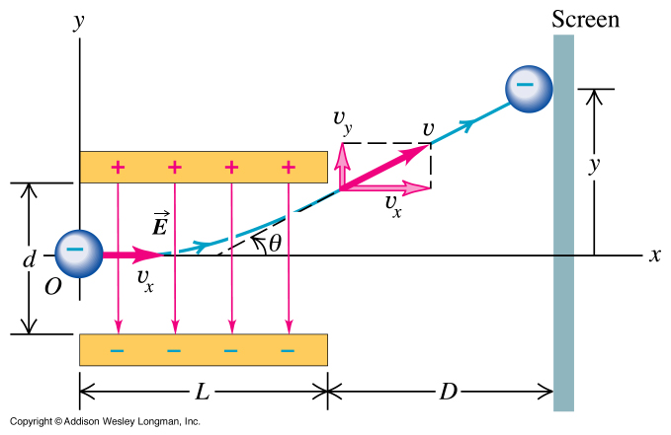
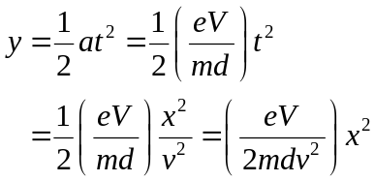
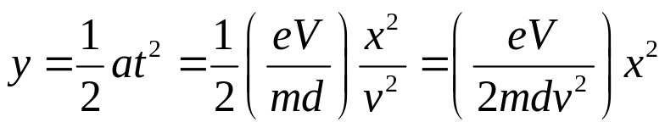
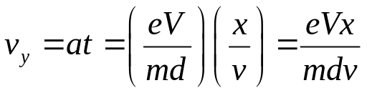
Deflection of Electrons in an Electric Field
Apply dynamic equations to motion of charged particles in an electric field.
Its verticle displacement:
Its verticle speed:
At any point:
The direction of the beam: The speed of the beam:
tan θ = v_{y} / v v_{r} = √(v² + v_{y}²)

Slide 15
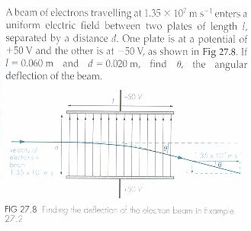
Example

Slide 16
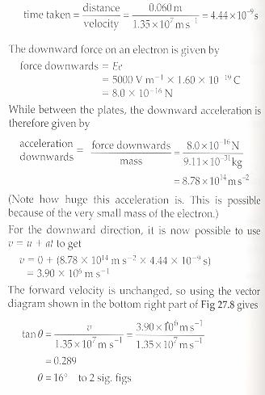
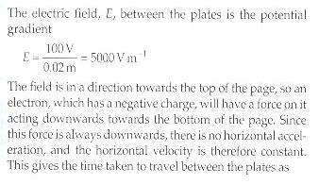
Solution

Slide 17
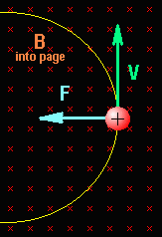
Electrons in a Magnetic Field
Magnetic Force, F = Bev
As it is making a circular motion:
Centripetal force = Magnetic force
mv² / r = Bev
v = Ber / m
OR
r = mv / Be

Slide 18
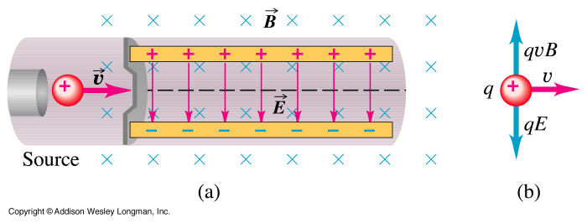
Combined Electric & Magnetic Fields
For zero deflection:
Magnetic force = Electric force
Bev = eE
v = E / B OR v = V / Bd
Particles with the right speed will move undeflected in the combined electric and magnetic fields.

Slide 19
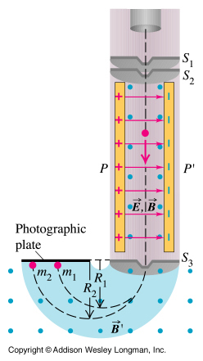
Specific Charge, e/m
If a particle carries a charge of e and has a mass m.
Then the ration e/m is the specific charge of the particle.
It is measured in C kg⁻¹
To find this value we use a mass spectrometer as shown.
Mass Spectrometer

Slide 20
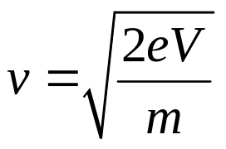
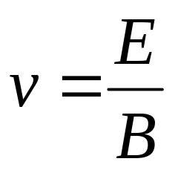
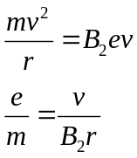

Determining e/m
The Electron Gun: Produce the electrons and accelerate them from the cathode to the anode
½ mv² = eV
The Velocity Selector: Electrons with the right speed will move undeflected in the combined electric and magnetic fields and will pass through a gap S₃.
The Deflector: Electrons emerging from slit S₃ is deflected through a magnetic field. They are made to strike a photographic plate and the radius of the circular motion measured.

Slide 21
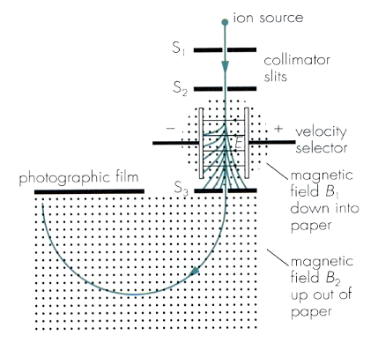
Determining e/m (1)
1. Ionisation:
Thermionic emission:
Current is supplied to a cathode (tungsten wire) and heating it up to produce electron beam.
2. Acceleration
The plates are connected to an accelerating +ve voltage V to accelerate the electrons though slit S₁ and S₂ into a velocity selector of cross E & B fields.
½ mv² = eV --- (1)
--- (2)
All electrons have the same K.E.

Slide 22
Determining (2)
3. Deflection:
Only those with speed
v = E / B
will move undeflected in the cross E & B fields, passing through slit S₃.
4. Detection:
The selected electrons are acted on by F_{em} and follow a circular path of radius r in the magnetic field B₂.
The radius can be measured as the electrons darken the photographic plate where they strike.
B e v = m v² / r --- (3)
e / m = v / (B r) --- (4)

Slide 23

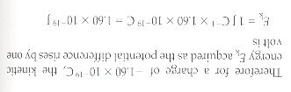
The electron-volt (eV)
Find the kinetic energy that an electron acquires if it falls through a potential difference of 1 V, and its charge is -1.60 x 10⁻¹⁹ C.
1.60 x 10⁻¹⁹ J
= 1 electron-volt (eV)

Slide 24
Exercise
An electron is accelerated by a p.d. of 500 V. Calculate the gain in kinetic energy
(i) in joules
(ii) in electron-volt
8.0 x 10⁻¹⁷ J
500 eV

Slide 25
Exercise
An electron leaves a cathode at zero potential and travels through a vacuum to an anode at + 200 V. Calculate
(i) the kinetic energy that it acquires.
(ii) the speed when it reaches the anode.
3.2 x 10⁻¹⁷ J
8.4 x 10⁶ m s⁻¹

Slide 26
Example
A hydrogen has a charge-to-mass ratio of q/m = 9.65 x 10⁷ C kg⁻¹. A Bainbridge mass spectrometer has B₁ = 0.93 T, B₂ = 0.61 T and E = 3.7 x 10⁶ V m⁻¹. Calculate the radius of the paths of each of the following ions in the mass spectrometer:
(a) H⁺
(b) He⁺
(c) He²⁺
0.0676 m
0.270 m
0.135 m

Slide 27
Example 1
An electron gun operating at 3000 V is used to shoot electrons into the space between two oppositely charge parallel plates. The plate spacing is 50 mm and its length is 100 mm.
Calculate the deflection of the electrons at the point where they emerge from the field when the plate p.d. is 100 V. Assume the specific charge e/m for the electron is 1.76 × 10¹¹ Ckg⁻¹

Slide 28
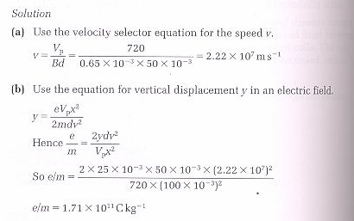
Solution 1

Slide 29
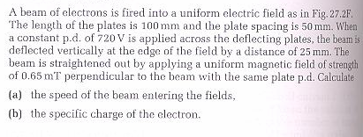
Example 2

Slide 30
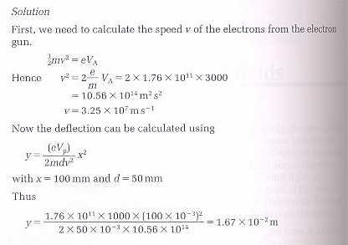
Solution 2

Slide 31
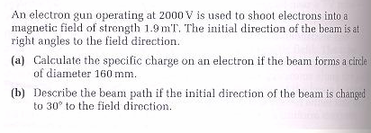
Example 3

Slide 32
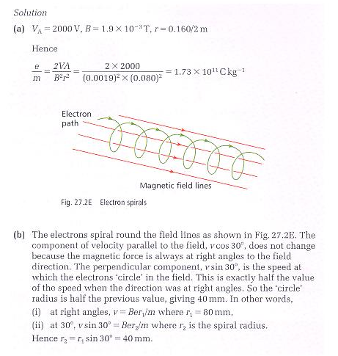
Solution 3

Slide 33
The End

